Slide 1

BY
PARTHASARATHI
DA-DS

Slide 2
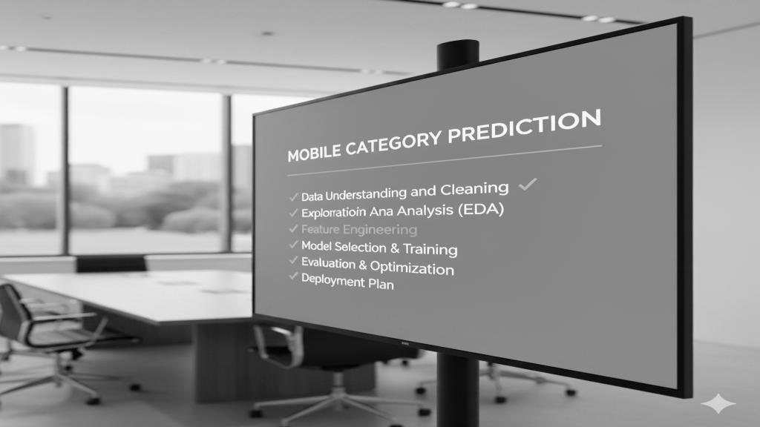
AGENDA
PROJECT OVERVIEW
WEB SCRAPING
DATA UNDERSTANDING
DATA CLEANING
SQL CONNECT
EDA
UNSUPERVISED LEARNING
SUPERVISED LEARNING
INSIGHTS AND RECOMMENDATION
CONCLUSION

Slide 3
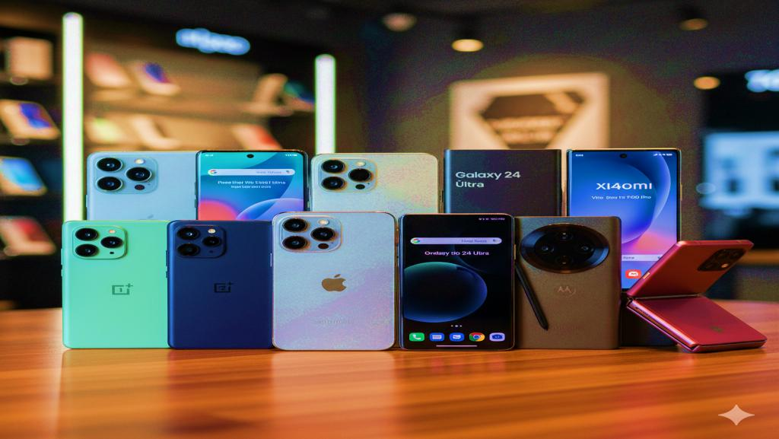
PROJECT OVERVIEW
Collect and Analyze raw mobile phone data from online sources
Understand market trends and customer preferences
Provide actionable recommendations for business growth
Enhance decision-making for product positioning
Support inventory management & pricing strategies

Slide 4

WEB SCRAPING
Sources: E-commerce websites Flipkart
Techniques: Web Scraping, APIs
Tools:
Selenium → Automates the web browser and loads dynamic content.
BeautifulSoup → Parses the HTML structure to extract specific elements.
Pandas → Stores and processes scraped data in a structured format.
time → Adds delays to ensure pages are fully loaded.
webdriver_manager → Automatically installs and manages
the Chrome driver.

Slide 5
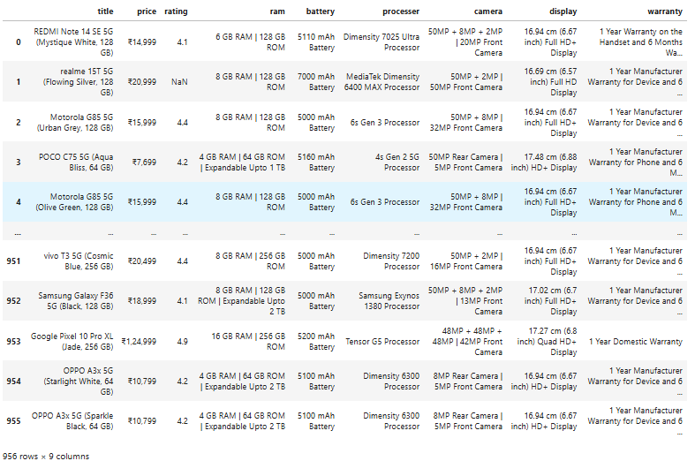
DATA UNDERSTANDING
The dataset collected from Flipkart .
Title
Price
Rating
Ram
Battery
Processer
Camera
Display warranty
Columns - 9 , Rows - 956

Slide 6


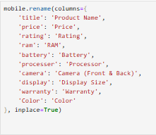
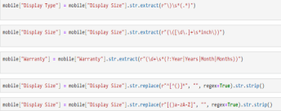
DATA CLEANING
Renamed & Extracted → Brand, RAM, ROM, Camera, Color
Handled Missing → Filled 0 / “Not Mentioned”
Cleaned Data → Removed ₹, GB, mAh, inch
Dropped Unwanted → Extra columns & irrelevant rows
Final Dataset → 15 Columns × 851 Rows, ready for EDA & ML

Slide 7
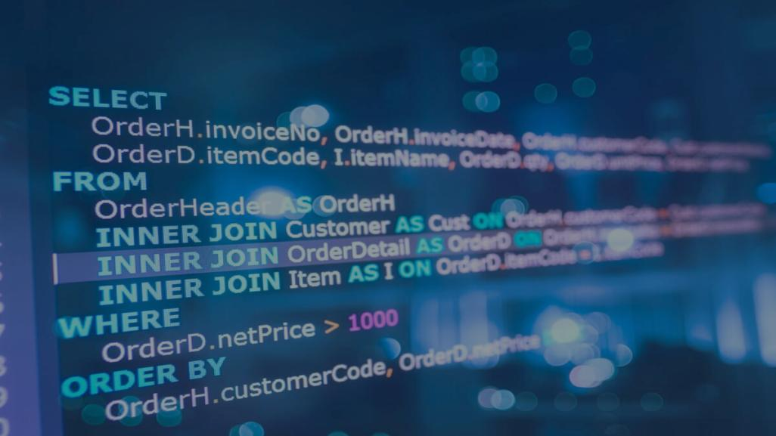
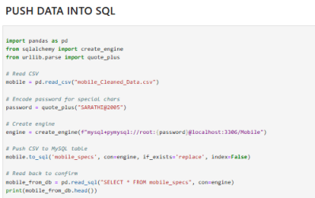
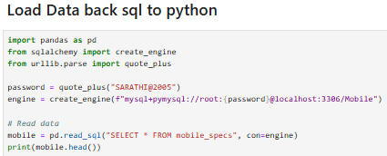
SQL CONNECT
Push Data → Stored cleaned dataset into SQL using SQLAlchemy.
Structured → Organized tables with rows & columns.
Fast Queries → Easy filtering, joins, aggregations.
Load Back → Retrieved into Python with read_sql().
Benefits → Scalable, reusable, team-friendly.

Slide 8

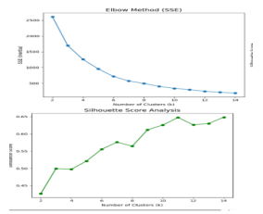
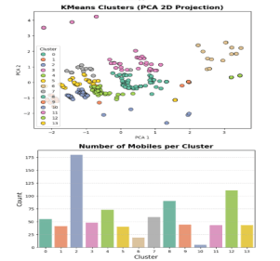
UNSUPERVISED LEARNING
Definition: Finds patterns from unlabeled data (no output labels).
Techniques Used: KMeans & Hierarchical Clustering.
Evaluation: Silhouette Score → KMeans = 0.6483 (Best, k=14).
Conclusion:
KMeans chosen → 13 meaningful clusters → supports market segmentation & product positioning

Slide 9
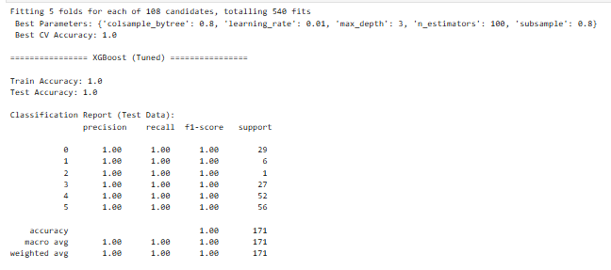
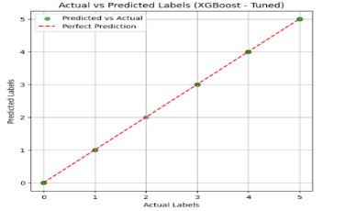
SUPERVISED LEARNING
Predict mobile category using features like Price, RAM,
ROM, Processor, Display.
Preprocessing → Encode categorical, scale numeric,
handle class balance.
Tested multiple models → Decision Tree (DT), Random Forest (RF), XGBoost.
XGBoost selected as final model for best accuracy and efficiency.
Provides accurate predictions to support business strategy.

Slide 10

INSIGHTS AND RECOMMENDATIONS
INSIGHTS
Popular brands: Google, Realme, Samsung, Redmi; Premium: Apple & Google.
Most phones ₹10K–₹20K; high RAM & battery → mid-to-premium.
Average rating >4.0; budget phones slightly lower.
Users prefer Mid Range & High Performance; Budget & Gaming less popular.

Slide 11
INSIGHTS AND RECOMMENDATIONS
RECOMMENDATIONS
Promote Mid Range & High Performance mobiles; highlight key features.
Budget buyers: check reviews; Heavy users/gamers: ≥8 GB RAM & ≥5000 mAh battery.
Premium buyers: trust Apple, Samsung, OnePlus.
Future: sentiment analysis, dataset updates, deploy XG Boost recommendations.

Slide 12

CONCLUSION
Scraping data from Flipkart.
Cleaning and preparing the data.
Using Exploratory Data Analysis (EDA) to find market trends.
Using unsupervised learning to segment phones.
Using supervised learning to predict phone CATEGORY, with the XG BOOST model achieving high accuracy.

Slide 13


